Slide 1
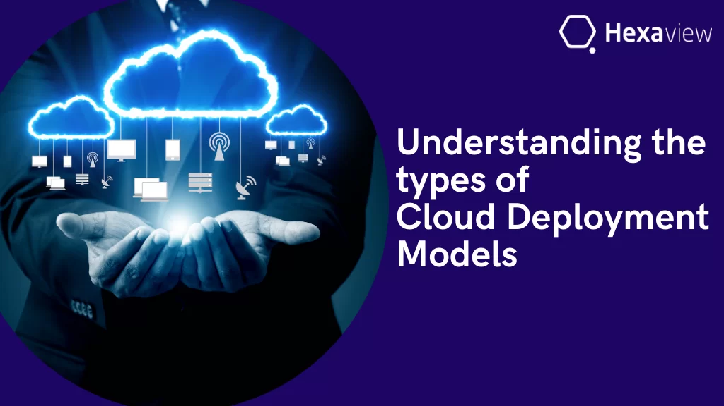
Cloud Deployment models

Slide 2
What is a Cloud Deployment Model?
Cloud Deployment Model functions as a virtual computing environment with a deployment architecture that varies depending on the amount of data you want to store and who has access to the infrastructure.

Slide 3
Types of Cloud Computing Deployment Models
The cloud deployment model identifies the specific type of cloud environment based on ownership, scale, and access, as well as the cloud’s nature and purpose. The location of the servers you’re utilizing and who controls them are defined by a cloud deployment model. It specifies how your cloud infrastructure will look, what you can change, and whether you will be given services or will have to create everything yourself. Relationships between the infrastructure and your users are also defined by cloud deployment types.

Slide 4
Public Cloud
Private Cloud
Hybrid Cloud
Community Cloud
Multi Cloud

Slide 5
Public Cloud
The public cloud makes it possible for anybody to access systems and services. The public cloud may be less secure as it is open to everyone. The public cloud is one in which cloud infrastructure services are provided over the internet to the general people or major industry groups. The infrastructure in this cloud model is owned by the entity that delivers the cloud services, not by the consumer. It is a type of cloud hosting that allows customers and users to easily access systems and services. This form of cloud computing is an excellent example of cloud hosting, in which service providers supply services to a variety of customers. In this arrangement, storage backup and retrieval services are given for free, as a subscription, or on a per-user basis. For example, Google App Engine etc.

Slide 6
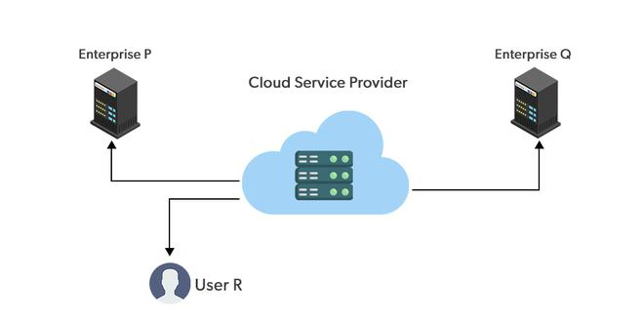
Public Cloud

Slide 7
Advantages of the Public Cloud Model
Minimal Investment: Because it is a pay-per-use service, there is no substantial upfront fee, making it excellent for enterprises that require immediate access to resources.
No setup cost: The entire infrastructure is fully subsidized by the cloud service providers, thus there is no need to set up any hardware.
Infrastructure Management is not required: Using the public cloud does not necessitate infrastructure management.
No maintenance: The maintenance work is done by the service provider (not users).
Dynamic Scalability: To fulfill your company’s needs, on-demand resources are accessible.
Disadvantages of the Public Cloud Model
Less secure: Public cloud is less secure as resources are public so there is no guarantee of high-level security.
Low customization: It is accessed by many public so it can’t be customized according to personal requirements.

Slide 8
Private Cloud
The private cloud deployment model is the exact opposite of the public cloud deployment model. It’s a one-on-one environment for a single user (customer). There is no need to share your hardware with anyone else. The distinction between private and public clouds is in how you handle all of the hardware. It is also called the “internal cloud” & it refers to the ability to access systems and services within a given border or organization. The cloud platform is implemented in a cloud-based secure environment that is protected by powerful firewalls and under the supervision of an organization’s IT department. The private cloud gives greater flexibility of control over cloud resources.

Slide 9
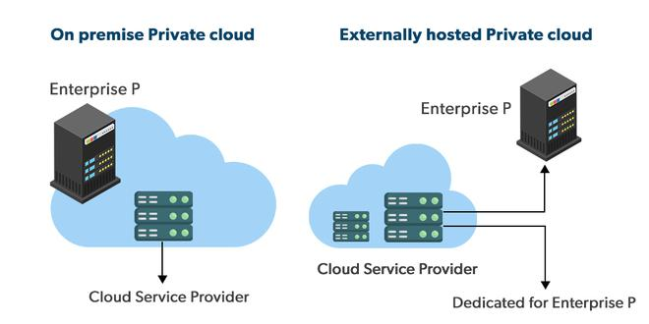
Private Cloud

Slide 10
Advantages of the Private Cloud Model
Better Control: You are the sole owner of the property. You gain complete command over service integration, IT operations, policies, and user behavior.
Data Security and Privacy: It’s suitable for storing corporate information to which only authorized staff have access. By segmenting resources within the same infrastructure, improved access and security can be achieved.
Supports Legacy Systems: This approach is designed to work with legacy systems that are unable to access the public cloud.
Customization: Unlike a public cloud deployment, a private cloud allows a company to tailor its solution to meet its specific needs.
Disadvantages of the Private Cloud Model
Less scalable: Private clouds are scaled within a certain range as there is less number of clients.
Costly: Private clouds are more costly as they provide personalized facilities.

Slide 11
Hybrid Cloud
By bridging the public and private worlds with a layer of proprietary software, hybrid cloud computing gives the best of both worlds. With a hybrid solution, you may host the app in a safe environment while taking advantage of the public cloud’s cost savings. Organizations can move data and applications between different clouds using a combination of two or more cloud deployment methods, depending on their needs.

Slide 12
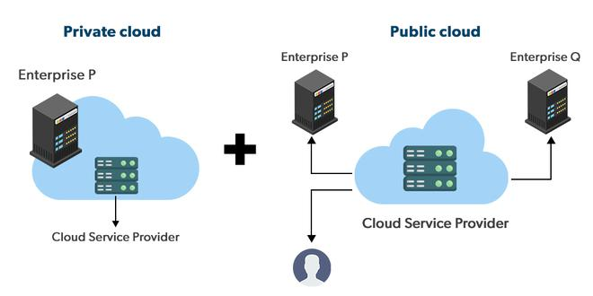
Hybrid Cloud

Slide 13
Advantages of the Hybrid Cloud Model
Flexibility and control: Businesses with more flexibility can design personalized solutions that meet their particular needs.
Cost: Because public clouds provide scalability, you’ll only be responsible for paying for the extra capacity if you require it.
Security: Because data is properly separated, the chances of data theft by attackers are considerably reduced.
Disadvantages of the Hybrid Cloud Model
Difficult to manage: Hybrid clouds are difficult to manage as it is a combination of both public and private cloud. So, it is complex.
Slow data transmission: Data transmission in the hybrid cloud takes place through the public cloud so latency occurs.

Slide 14
Community Cloud
It allows systems and services to be accessible by a group of organizations. It is a distributed system that is created by integrating the services of different clouds to address the specific needs of a community, industry, or business. The infrastructure of the community could be shared between the organization which has shared concerns or tasks. It is generally managed by a third party or by the combination of one or more organizations in the community.

Slide 15
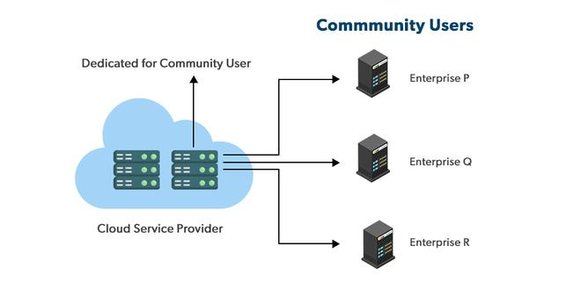
Community Cloud

Slide 16
Advantages of the Community Cloud Model
Cost Effective: It is cost-effective because the cloud is shared by multiple organizations or communities.
Security: Community cloud provides better security.
Shared resources: It allows you to share resources, infrastructure, etc. with multiple organizations.
Collaboration and data sharing: It is suitable for both collaboration and data sharing.
Disadvantages of the Community Cloud Model
Limited Scalability: Community cloud is relatively less scalable as many organizations share the same resources according to their collaborative interests.
Rigid in customization: As the data and resources are shared among different organizations according to their mutual interests if an organization wants some changes according to their needs they cannot do so because it will have an impact on other organizations.

Slide 17
Multi-Cloud
We’re talking about employing multiple cloud providers at the same time under this paradigm, as the name implies. It’s similar to the hybrid cloud deployment approach, which combines public and private cloud resources. Instead of merging private and public clouds, multi-cloud uses many public clouds. Although public cloud providers provide numerous tools to improve the reliability of their services, mishaps still occur. It’s quite rare that two distinct clouds would have an incident at the same moment. As a result, multi-cloud deployment improves the high availability of your services even more.

Slide 18
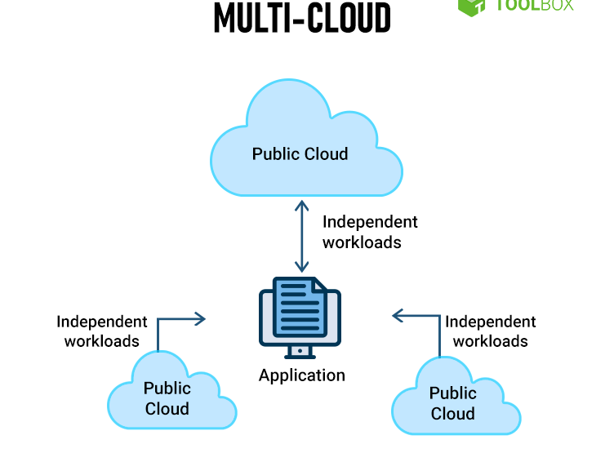
Multi Cloud

Slide 19
Advantages of the Multi-Cloud Model
You can mix and match the best features of each cloud provider’s services to suit the demands of your apps, workloads, and business by choosing different cloud providers.
Reduced Latency: To reduce latency and improve user experience, you can choose cloud regions and zones that are close to your clients.
High availability of service: It’s quite rare that two distinct clouds would have an incident at the same moment. So, the multi-cloud deployment improves the high availability of your services.
Disadvantages of the Multi-Cloud Model
Complex: The combination of many clouds makes the system complex and bottlenecks may occur.
Security issue: Due to the complex structure, there may be loopholes to which a hacker can take advantage hence, makes the data insecure.

Slide 20

THANK yOU

